Slide 1
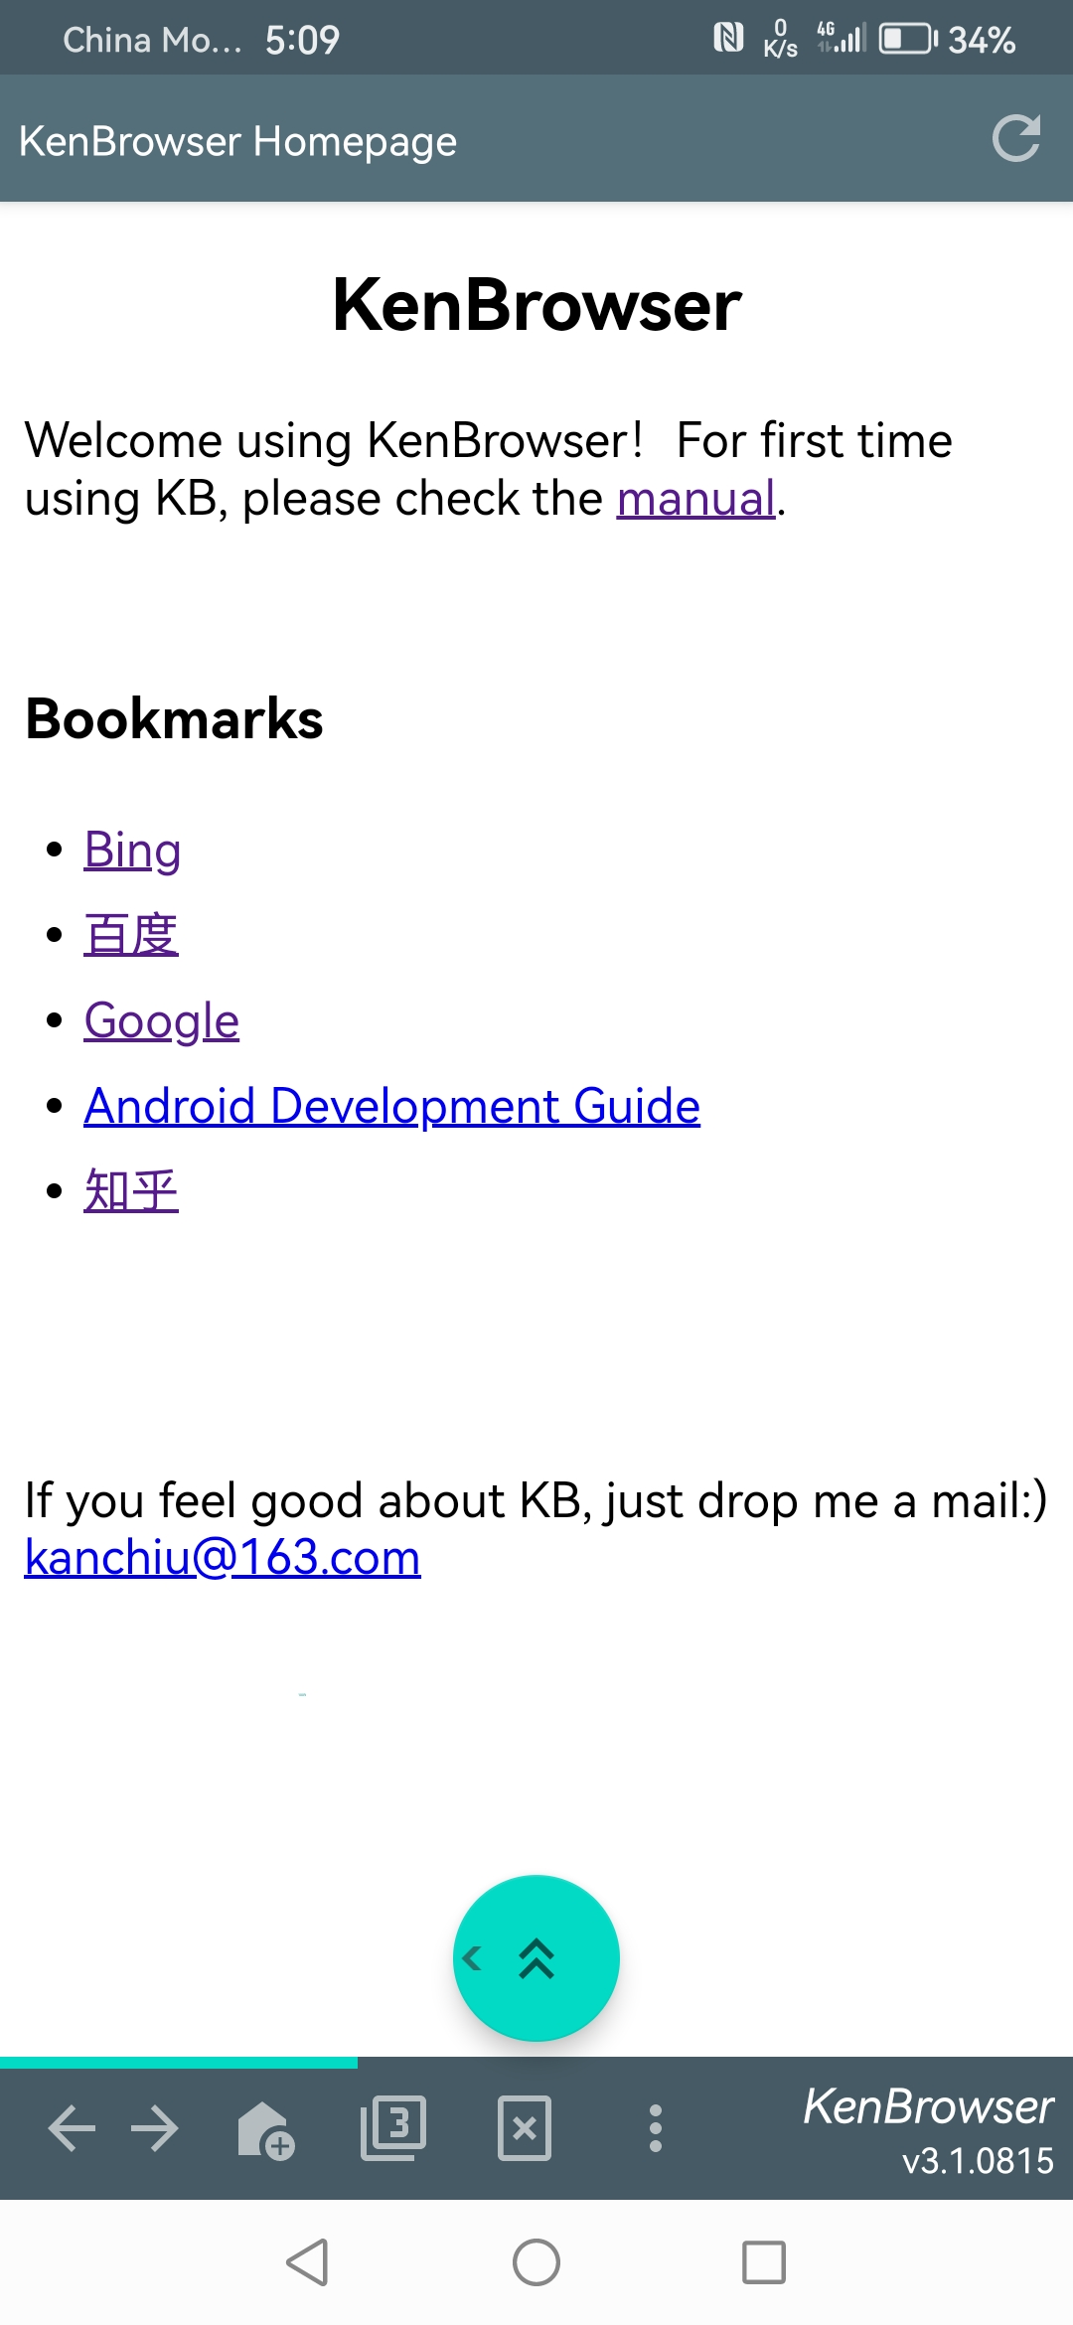
KenBrowser
If you tired of those big and heavy mobile browsers in market, try this one!
Floating button enables you use only one finger to scroll page up/down, swipe left/right, and auto-scrolling!
Can hide your private bookmarks
Customized Javascript injecting in webpages, supports TamperMonkey

Slide 2

KB

